Slide 1
New Evaluation System
For School Counselors
2014/2015

Slide 2
Evaluation Timeline
Training on the new instrument will happen this year
Each meeting we will be reviewing over a specific part
The new instrument will not be used until next year.

Slide 3
Evaluation System connects directly to RAMP

Slide 4
The performance evaluation rubric is based on the 2008 NC Professional School Counseling Standards
Standard 1 – School counselors demonstrate leadership, advocacy, and collaboration.
Standard 2 – School counselors promote a respectful environment for a diverse population of students.
Standard 3 – School counselors understand and facilitate the implementation of a comprehensive school counseling program.
Standard 4 – School counselors promote learning for all students
Standard 5 – School counselors actively reflect on their practice.
No Standard 6 or 8

Slide 5
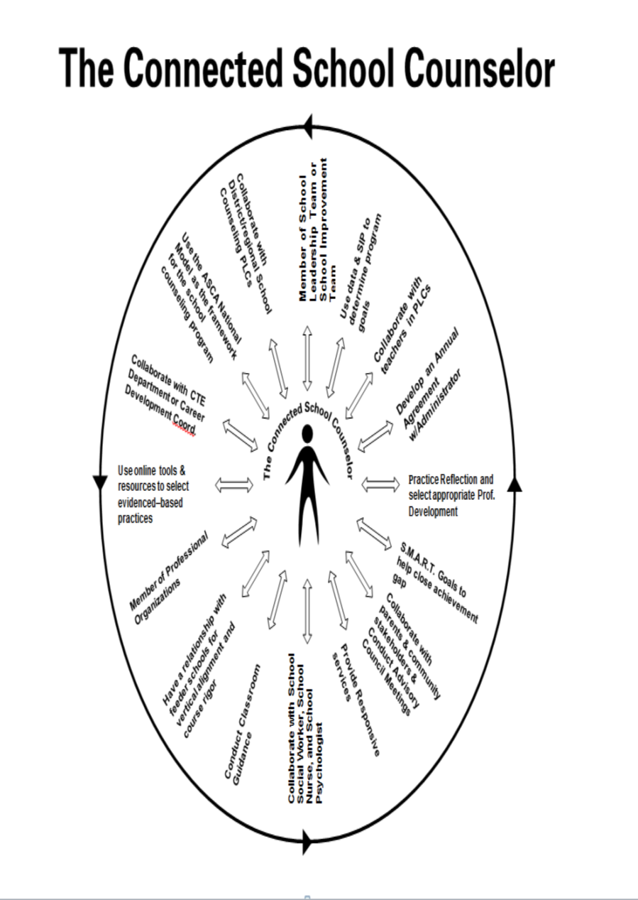

Slide 6
Where do I go to find the information?
Training Links: http://schoolcounseling.ncdpi.wikispaces.net/School+Counselor+Evaluation+Instrument
Evaluation Instrument: http://ncees.ncdpi.wikispaces.net/Support+Staff

Slide 7
Performance Appraisal Ratings
•Developing – an awareness or some knowledge
•Proficient – demonstrating/doing - implementation of standard. You are a good counselor who is able to meet the requirements of your job role on a routine basis
•Accomplished – mentor other counselors or share components of school counseling program within school/district
•Distinguished – “one in a million type of work” - able to share successful strategies, programs you/team developed on a wide-scale basis such as district, state or nationally
*******************************************************************************
Not evidenced – professional area to work on developing

Slide 8
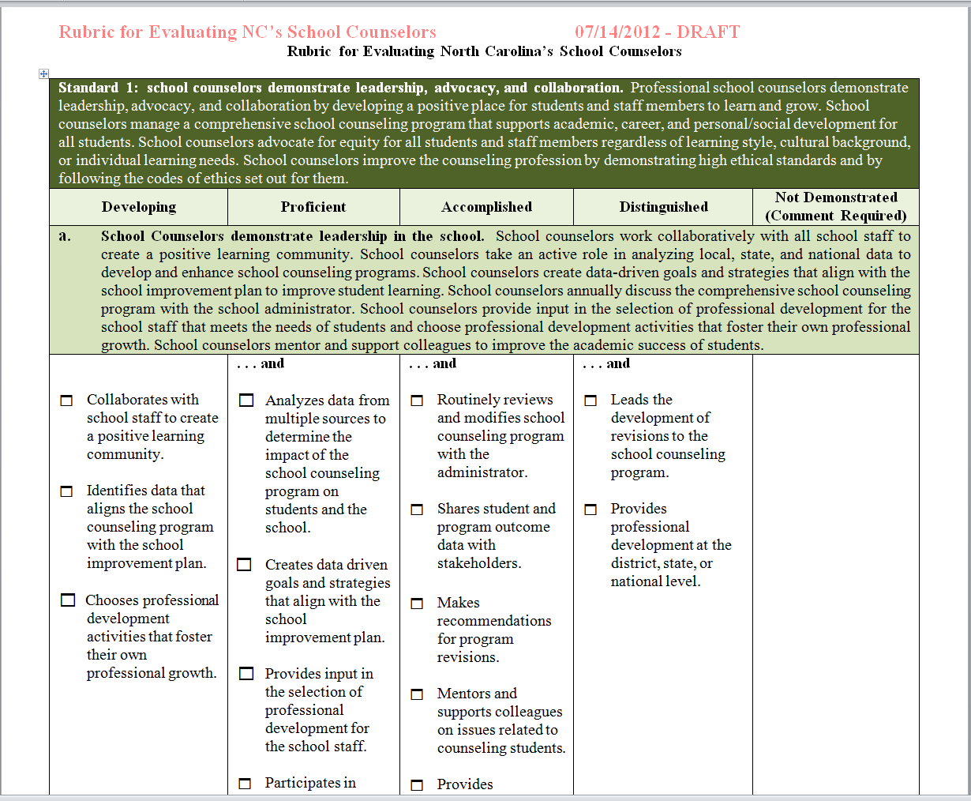
Notes:
Growth model

Slide 9
Self Evaluation
Complete the self evaluation (only for your use)
Use the sticky notes to write down questions you might have about any part on the self evaluation you might have.
We will collect the sticky notes at the end but we will NOT collect the self evaluation
Notes:
Give enough time to complete and form questions

Slide 10
Self-Evaluation
http://ncees.ncdpi.wikispaces.net/file/view/SC%20Rubric%20for%20Self-Assessment%20Evaluation.pdf/452702926/SC%20Rubric%20for%20Self-Assessment%20Evaluation.pdf

Slide 11

Next Steps???
Discuss the possibilities at your table and place suggestions on large note card located at each table.

Slide 12
Useful Websites
•School Counseling Wikispace: www.schoolcounseling.ncdpi.wikispaces.net
•NCDPI School Counseling LiveBinders – link to this site from the wikispace
•American School Counselor Association (ASCA) http://www.schoolcounselor.org/
•NC Falcon: http://www.ncpublicschools.org/acre/falcon/
( note the Professional Development tab on the left – formative
assessments)
•NC Education: RBT video https://center.ncsu.edu/nc/login/index.php

