Slide 1
Credit by Demonstrated Mastery (CDM)
An Overview for School Counselors
December 10, 2013

Slide 2
Rationale
“Credit by demonstrated mastery” is the process by which LEAs shall, based upon a body-of-evidence, award a student credit in a particular course without requiring the student to complete classroom instruction for a certain amount of seat time.
Providing students with an opportunity to reach higher level course work more efficiently by showing mastery over lower level courses

Slide 3
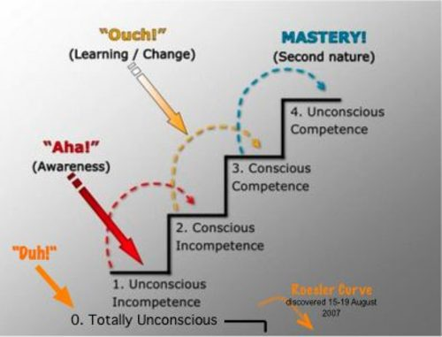
Mastery
How can we meet kids who enter a classroom already here?

Slide 4
Onslow County’s Timeline
January – May 2013
EOC Courses Available for CDM
May 2013- January 2014
Develop process for High School Courses
Not including AP, IB, certain CTE courses
Biology, Math I, English II
Education for students, counselors, administrators, parents
January 2013
February EOC Testing Window

Slide 5
Resources
http://cdm.ncdpi.wikispaces.net
Implementation Guide (will be updated based on revised State Board Policy)
Student Family Agreement
Application to be a part of CDM
CDM Long Term Implications
CDM FAQs

Slide 6
Spring 2013 Timeline
January – Mid-February: Share CDM opportunities with students and families. Have student/family discussions and advisement. Accept CDM Applications. Set Application deadline date based on local needs.
Last 2 weeks of February: Implement Phase 1 Assessment of the CDM process.
For students attempting to earn CDM for EOC courses (Math I, Biology, English II), administer the appropriate EOC.
First week of March: Report results to students/families.

Slide 7
Spring 2014 Timeline Continued
Remainder of March: Schedule Phase 2 artifact work for students who achieve the required standard on the assessment.
First 2 weeks of April: Conduct artifact review.
Mid-April: Provide results to students/families and discuss course schedule changes. Begin a ten-calendar-day window for submission of appeals (appeal only of artifact not assessment).
First week of May: Conduct appeals reviews.
Second week of May: Finalize appeal decisions and share results; amend Fall semester schedules as needed.

Slide 8
Next Steps

Slide 9
Questions

